Slide 1
Recurrent Neural networks
Idea
Use temporal covariations/context to refine prediction at some time t

Slide 2
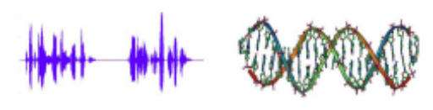
Recurrent Neural networks
Sequence learning is the study of machine learning algorithms designed for sequential data
Sequential data: data points come in order and successive points may be dependent, e.g.,
  Letters in a word
  Words in a sentence/document
  Phonemes in a spoken word utterance
  Time series
  Frames in a video, etc.
So far, we assume that data points in a dataset are i.i.d (independent and identically distributed)
Does not hold in many applications

Slide 3
Recurrent Neural networks
Plain CNNs are not typically good at length-varying input and output.
Difficult to define input and output
  Remember that
    Input image is a 3D tensor (width, length, color channels)
    Output is a fixed number of classes.
  Sequence could be:
    "I know that you know that I know that you know that I know that you know that I know that you know that I know that you know that I know that you know that I don't know"
    Or "I don't know"
Input and output are strongly correlated within the sequence.
(Still, people figured out ways to use CNN on sequence learning)

Slide 4
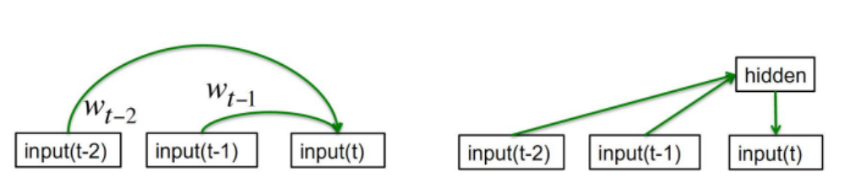
Sequence labeling
1. Autoregressive models
- Predict the next term in a linear sequence from a fixed number of previous terms using delay taps.
2. Feed-forward neural nets
- These generalize autoregressive models by using one or more layers of non-linear hidden units
Memoryless models: limited word-memory window; hidden state cannot be used efficiently.

Slide 5
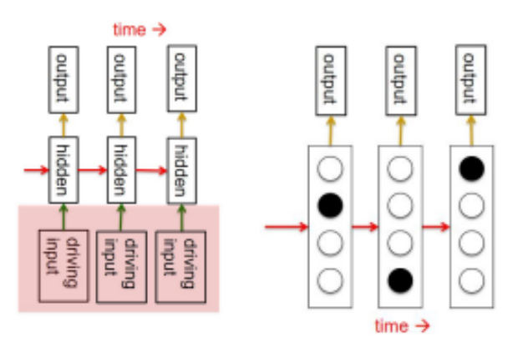
Sequence labeling
3. Linear Dynamical Systems
- Generative models. They have a hidden state that cannot be observed directly.
4. Hidden Markov Models
- Have a discrete one-of-N hidden state. Transitions between states are stochastic and controlled by a transition matrix. The outputs produced by a state are stochastic.
Memoryful models,
time-cost to infer the hidden state distribution.

Slide 6
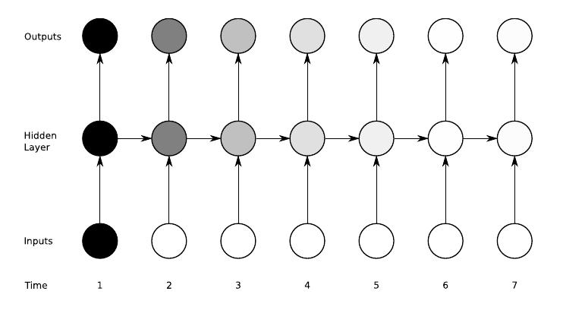
Sequence labeling
Recurrent Neural Networks
- Update the hidden state in a deterministic nonlinear way.
- In a simple speaking case, we send the chosen word back to the network as input.

Slide 7
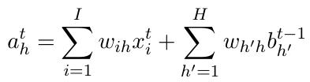

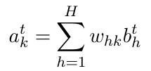
Vanilla forward path RNN
Recurrent Neural Networks
The forward pass of a vanilla RNN
  The same as that of a perceptron with a single hidden layer
  Except that activations arrive at the hidden layer from both the current external input and the hidden layer activations one step back in time.
For the input to hidden units we have
For the output unit we have

Slide 8
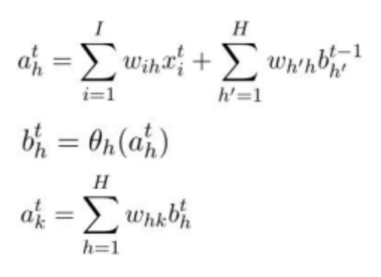
Vanilla forward path RNN
Recurrent Neural Networks
The complete sequence of hidden activations can be calculated by starting at t = 1 and recursively applying the three equations, incrementing t at each step.

Slide 9
Vanilla forward path RNN
Recurrent Neural Networks
Given the partial derivatives of the objective function with respect to the network outputs, we now need the derivatives with respect to the weights.
We focus on BPTT since it is both conceptually simpler and more efficient in computation time (though not in memory). Like standard back-propagation, BPTT consists of a repeated application of the chain rule.

Slide 10
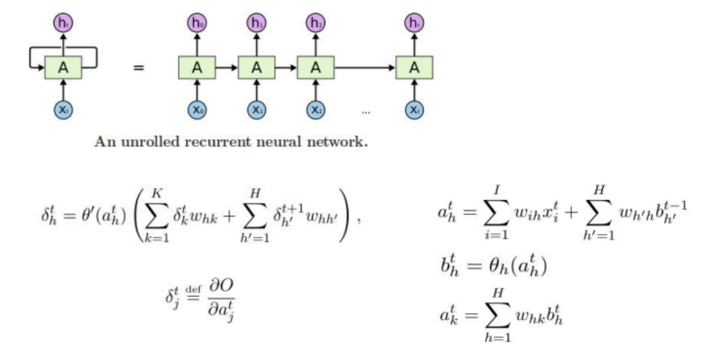
Vanilla backward path RNN
Recurrent Neural Networks
Back-propagation through time
Don't be fooled by the fancy name. It's just the standard back-propagation.

Slide 11

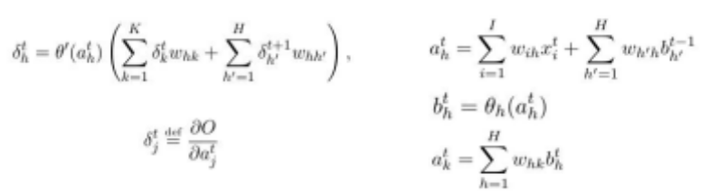
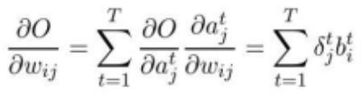
Vanilla backward path RNN
Back-propagation through time
The complete sequence of delta terms can be calculated by starting at t = T and recursively applying the below functions, decrementing t at each step.
Note that , since no error is received from beyond the end of the sequence.
Finally, bearing in mind that the weights to and from each unit in the hidden layer are the same at every time-step, we sum over the whole sequence to get the derivatives with respect to each of the network weights

Slide 12
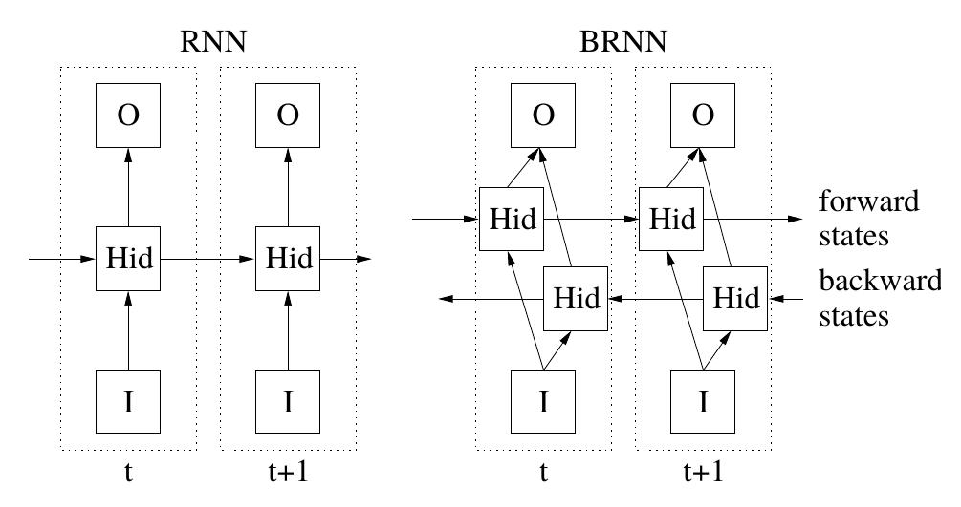
Vanilla bidirectional path RNN
For many sequence labeling tasks, we would like to have access to future.
Bidirectional

Slide 13
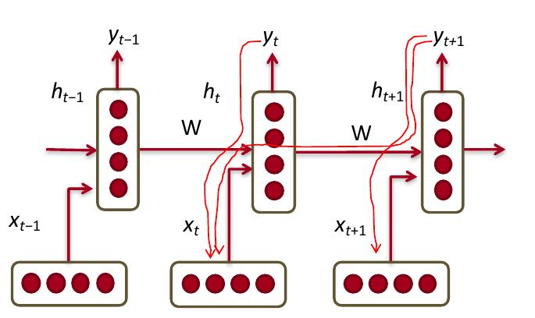
Problem: Vanishing and exploding gradients
Multiply the same matrix at each time step during back- prop

Slide 14
LSTM: long short term memory
As discussed earlier, for standard RNN architectures, the range of context that can be accessed is limited.
The problem is that the influence of a given input on the hidden layer, and therefore on the network output, either decays or blows up exponentially as it cycles around the network's recurrent connections.
The most effective solution so far is the Long Short Term Memory (LSTM) architecture (Hochreiter and Schmidhuber, 1997).
The LSTM architecture consists of a set of recurrently connected subnets, known as memory blocks. These blocks can be thought of as a differentiable version of the memory chips in a digital computer. Each block contains one or more self-connected memory cells and three multiplicative units that provide continuous analogues of write, read and reset operations for the cells
The input, output and forget gates.

Slide 15
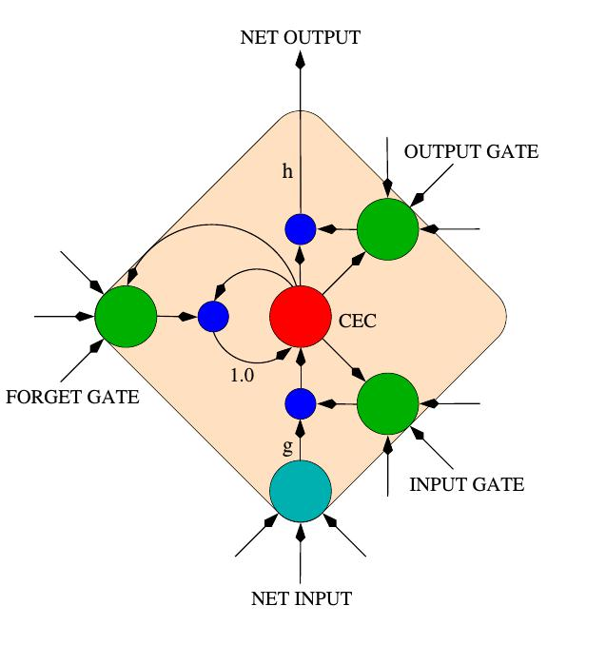
LSTM: long short term memory
The multiplicative gates allow LSTM memory cells to store and access information over long periods of time, thereby avoiding the vanishing gradient problem
For example, as long as the input gate remains closed (i.e. has an activation close to 0), the activation of the cell will not be overwritten by the new inputs arriving in the network, and can therefore be made available to the net much later in the sequence, by opening the output gate.

Slide 16
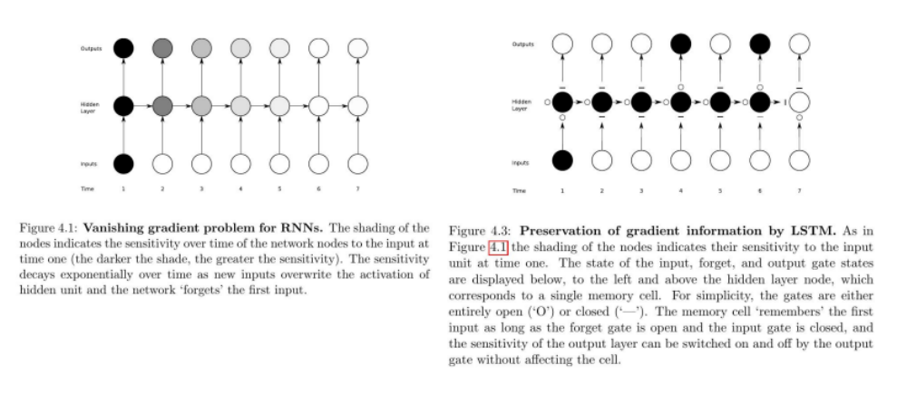
LSTM: long short term memory
Comparison

